Slide 1
Values and motivators that drive my leadership
By Name
Registration Number
Date

Slide 2

My life values
-My highest priority life values are
Education
Health
Personal Achievement
Marriage
Family

Slide 3

Translation of values
-I like speaking in public
-serving others
-Reading more on the values of a leader
-reading on the current political situation in the state and country as whole

Slide 4

My goals
My goals are achievable, realistic, and time-bound. They include;
To maintain my GPA
To finish university in Summer 2019
To graduate from the university with a minor in Political Science
To start my own business
To have kids and family

Slide 5
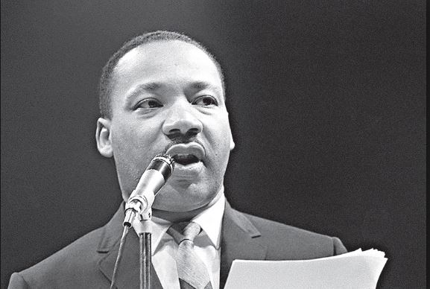
My action steps
-If I plan on making progress I will;
Allow feedback and corrections from my teacher and colleagues
Practice more speaking in public
Make mini goals that will enable me track achievements
Learn from the best public speakers or even politicians

